Slide 1

Recursive methods
Are they more effective than a for loop?

Slide 2
The short answer
NO!

Slide 3

But let’s look in depths!
http://pythontutor.com/

Slide 4
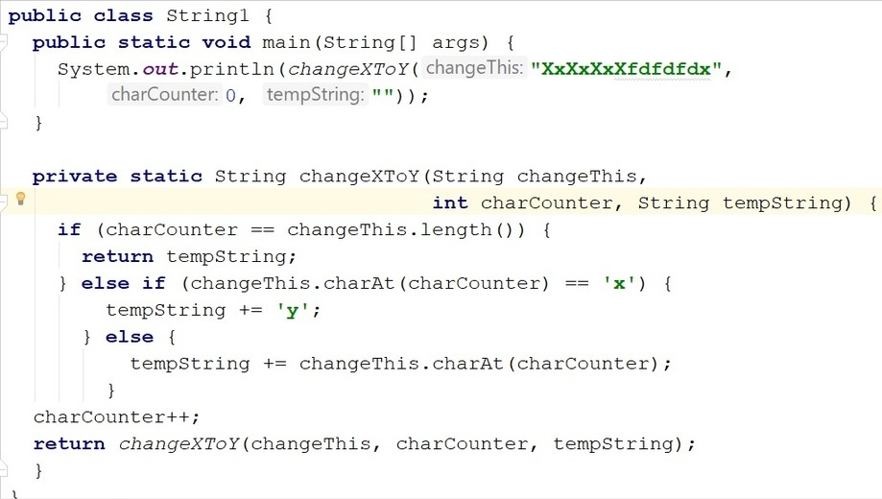
With recursion (17, 86)

Slide 5
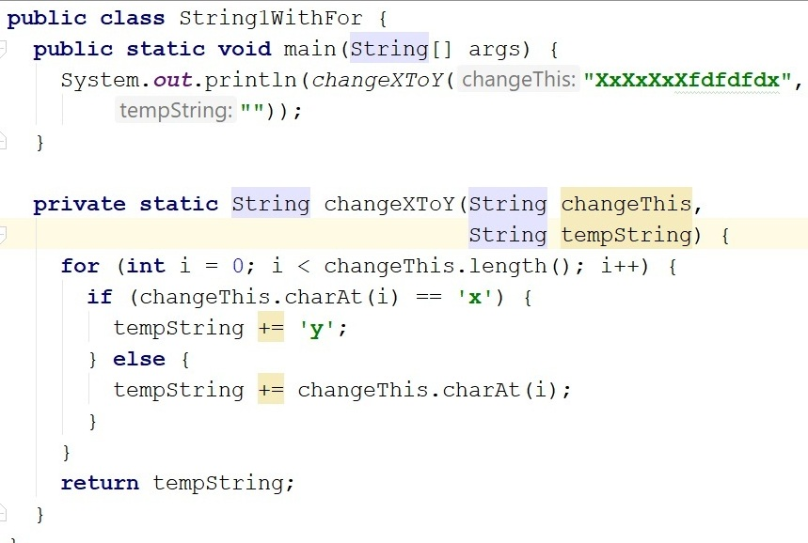
With for loop (16, 65)

Slide 6
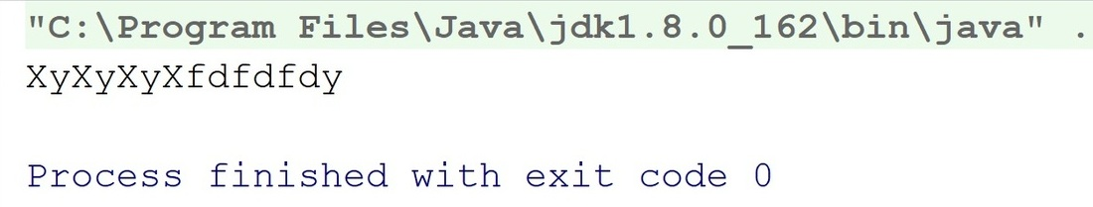
Same result

Slide 7
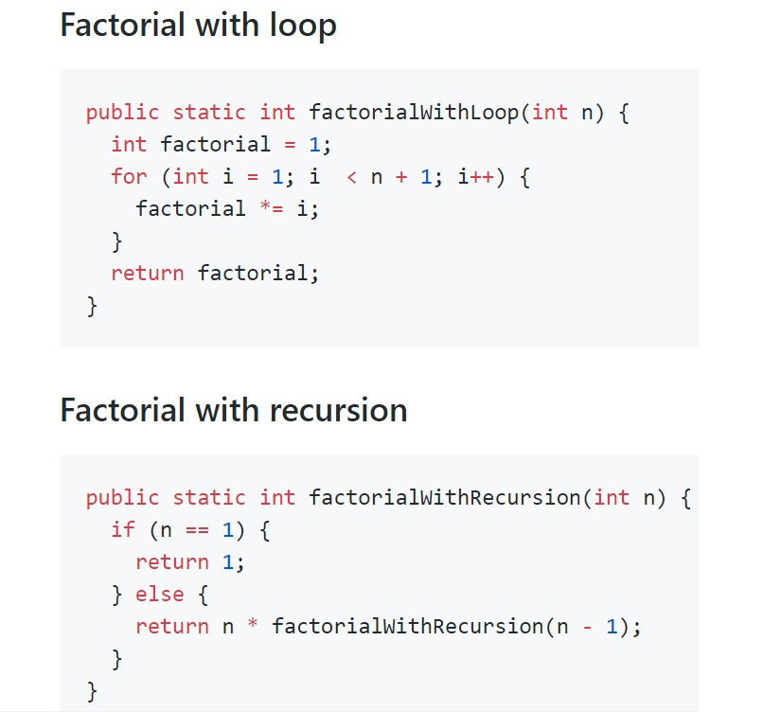
Another example

Slide 8
So which to use?
Depends on your preferences and logic
Depends on the task
Depends on the programming language you are using

Slide 9
BUT KEEP IN MIND!!!
On a jobinterview you should be able to solve a problem both ways, vice versa!

Slide 10
Thank you for
your attention!

